Slide 1
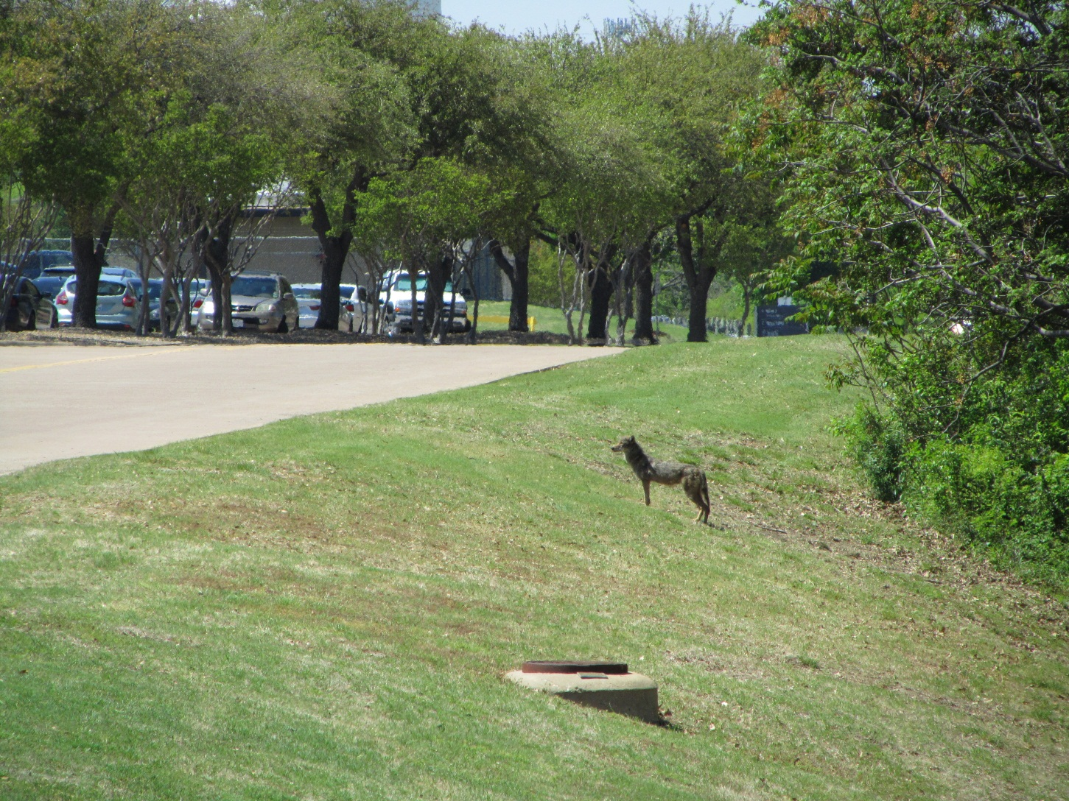
South Campus Wildlife

Slide 2
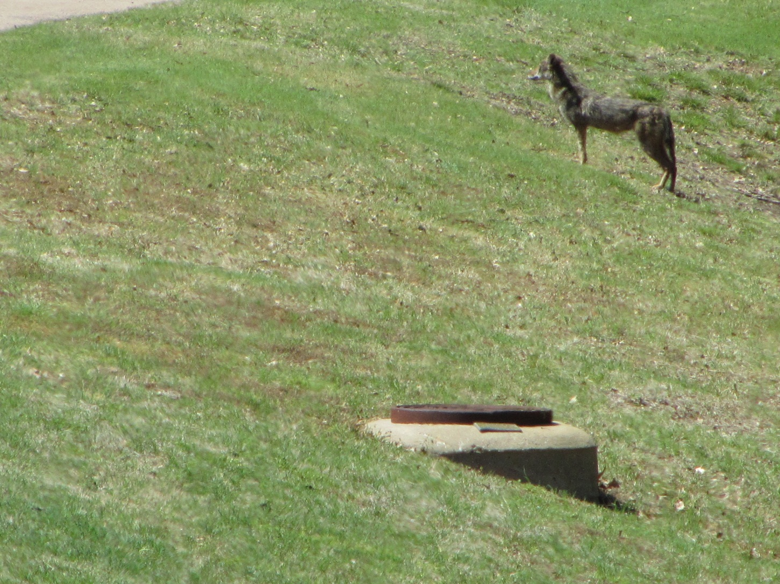
South Campus Wildlife

